Slide 1
AIMS of using Artist Sources
By Paul Carney
www.paulcarneyarts.com

Slide 2
AQA GCSE Specification
Ofsted Inspection Framework 2021

Slide 3
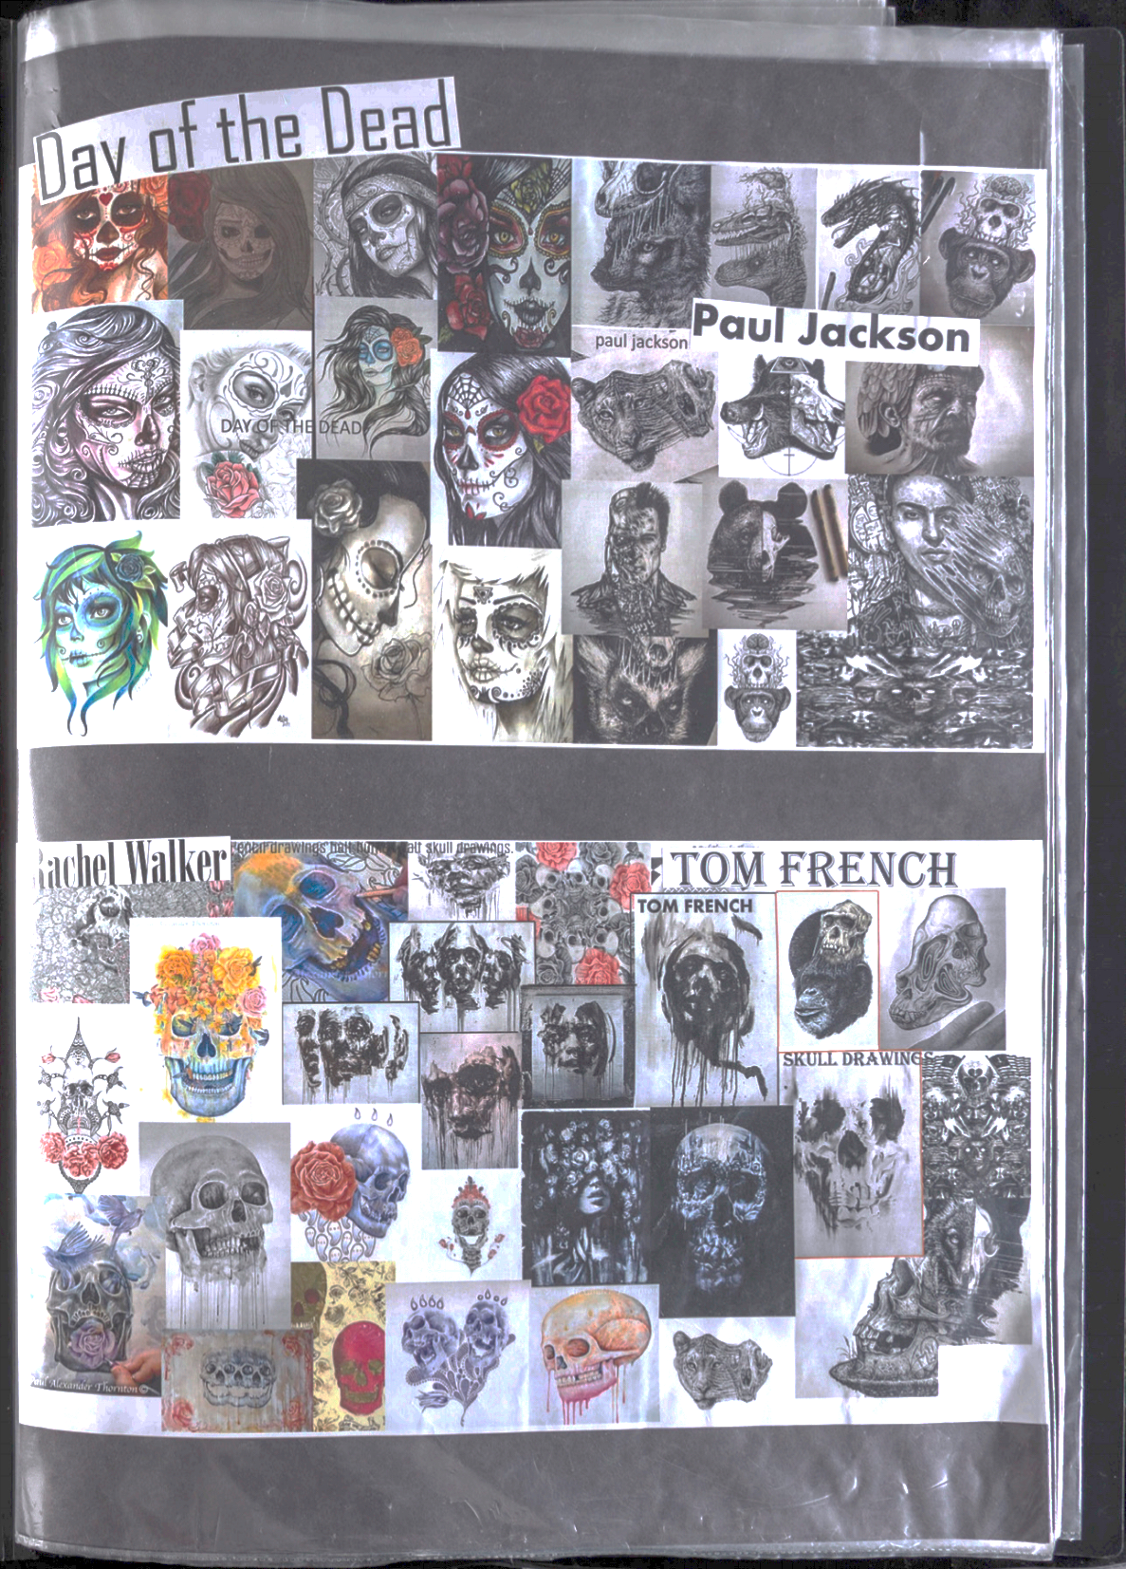

Slide 4
The AIMS of using sources
A – Approaches. To learn how to adapt & manipulate the approaches artists have used.
I – Inspiration and ideas.
M – Meaning. Understand the deeper meanings behind artists work then re-applying it
S –Skills & Techniques. To learn how artists made their art so you can learn from them.
www.paulcarneyarts.com

Slide 5
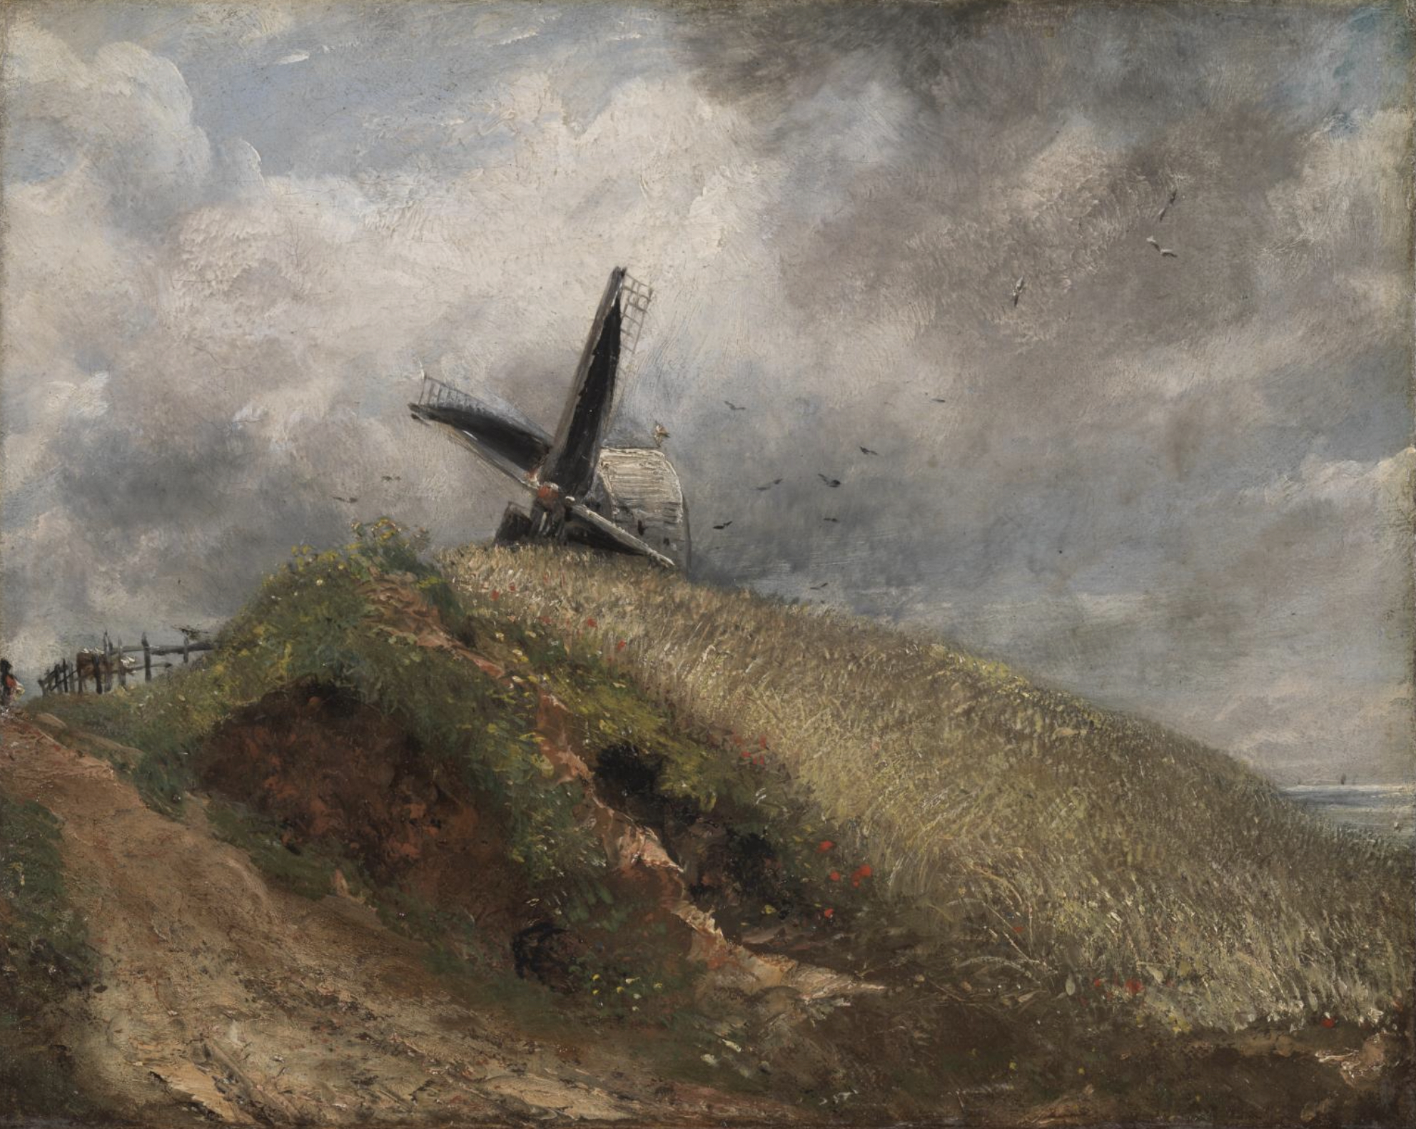
A - Understand how the Approach artists use affects the outcome
We can take the same theme yet interpret it through different approaches; realist, abstract, contemporary, sculptural…
www.paulcarneyarts.com
John Constable A Windmill near Brighton 1824

Slide 6
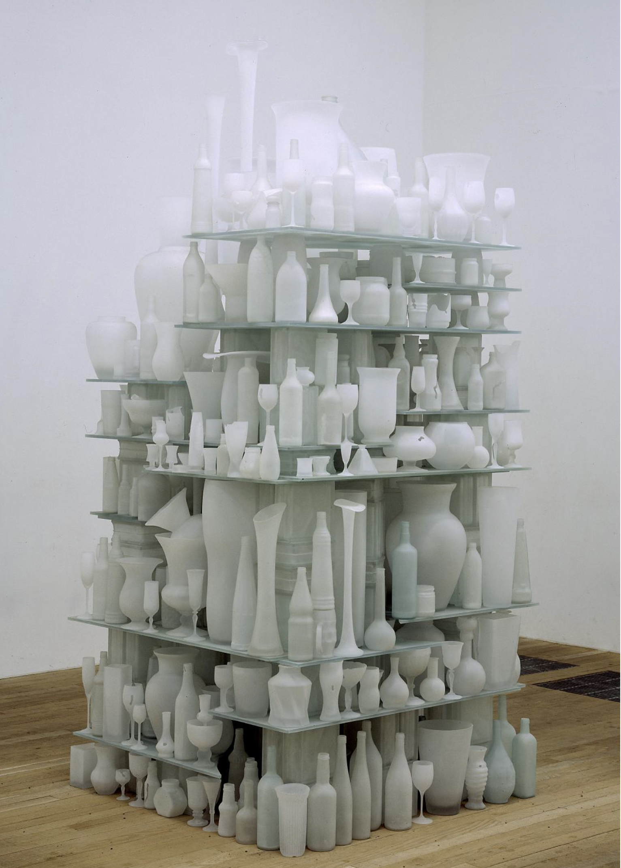
A - Understand how the Approach artists use affects the outcome
We can take the same theme yet interpret it through different approaches; realist, abstract, contemporary, sculptural…
www.paulcarneyarts.com
Tony Cragg
Cumulus
1998

Slide 7
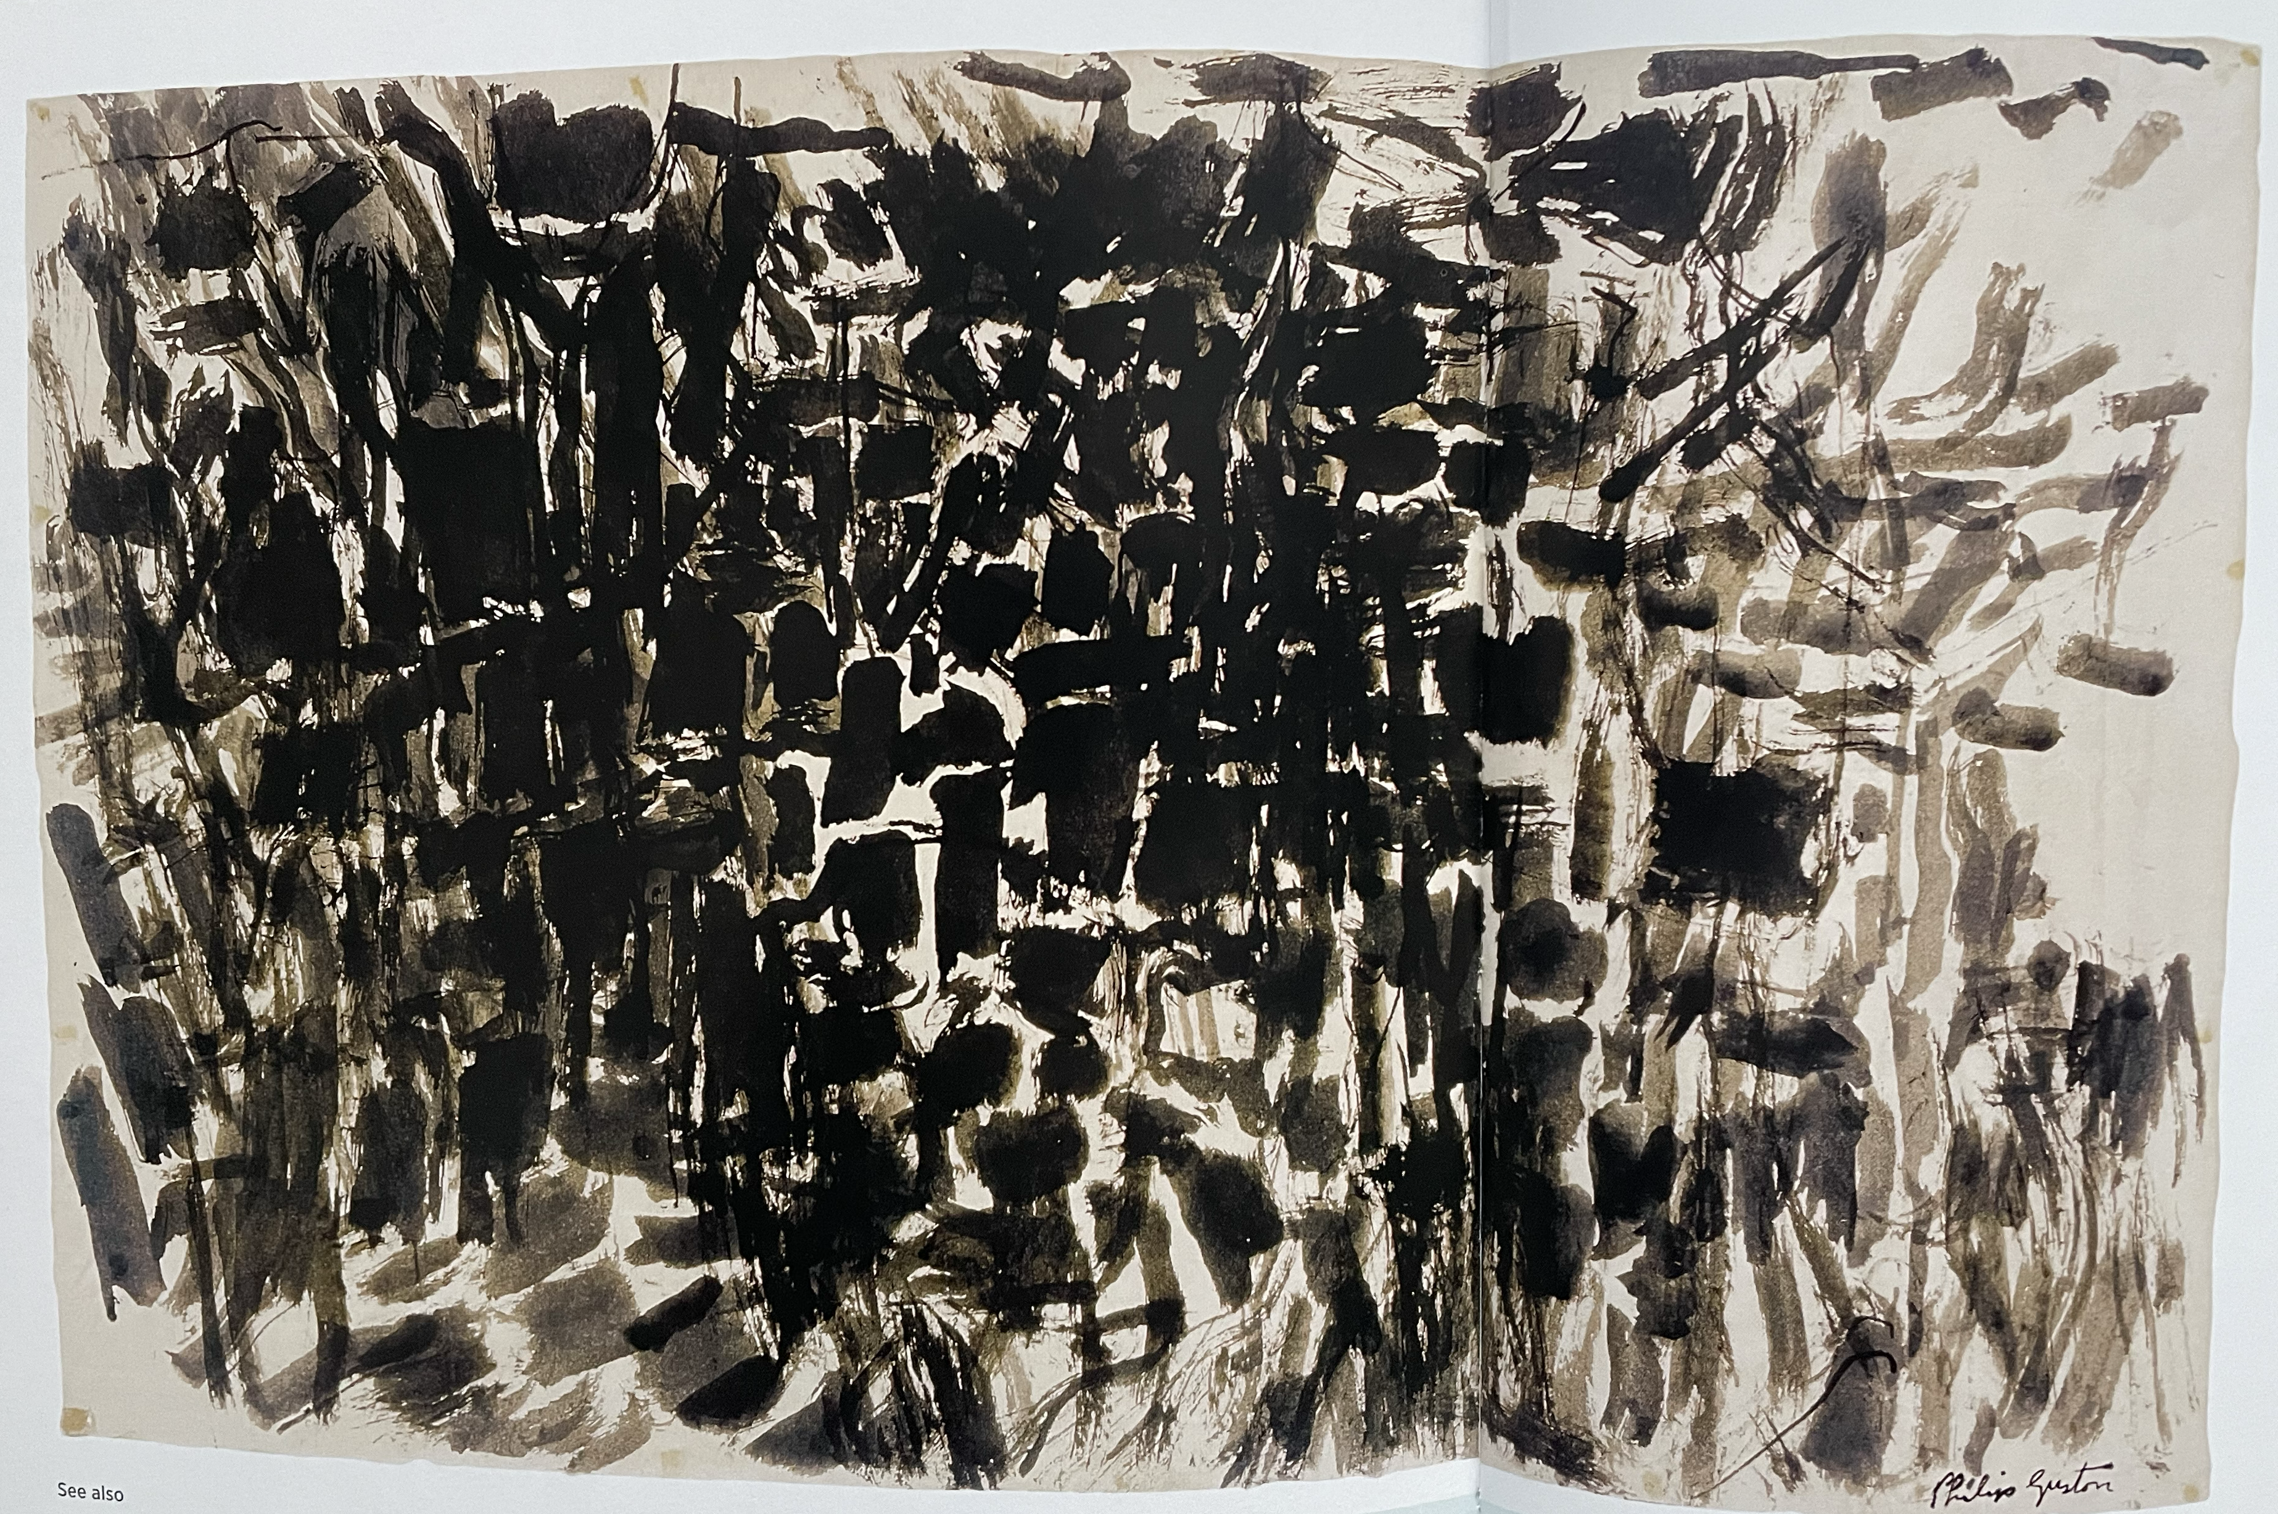
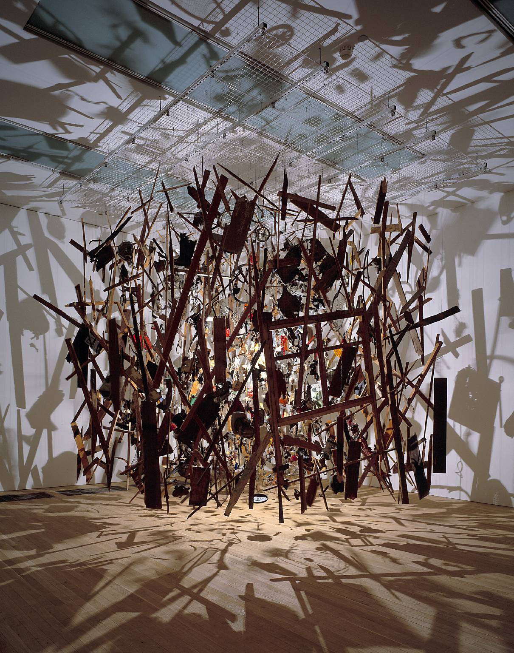
I - Use artists to get Inspiration
Steal ideas don’t borrow them. Borrowing means it still belongs to the owner, stealing means its mine! Take their idea and own it.
Philip Guston untitled 1957
www.paulcarneyarts.com
Cornelia Parker Cold Dark Matter: An Exploded View 1991

Slide 8
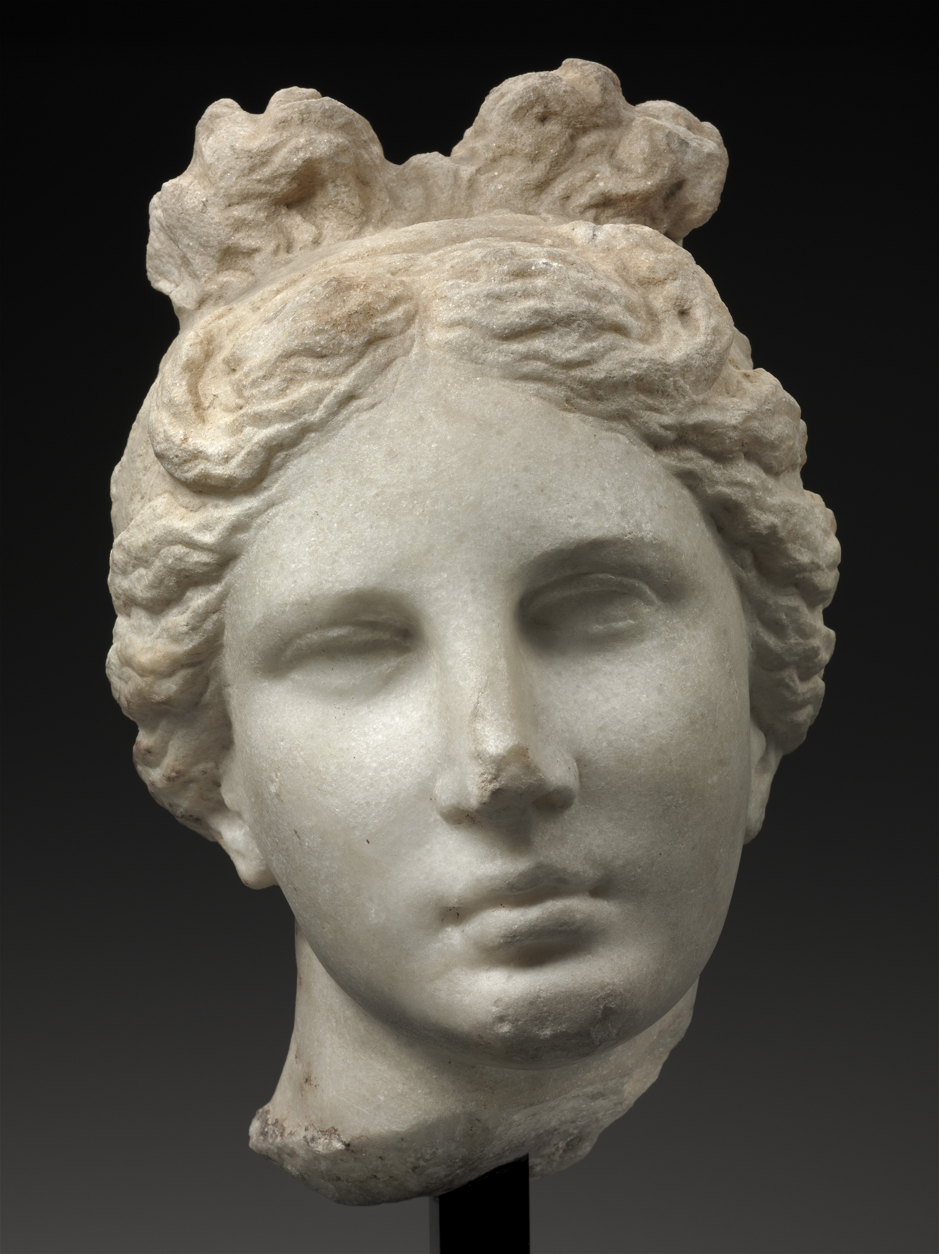
M – Learn the Meaning behind artists’ work
Discover the cognitive thinking process behind the way in which artists interpreted themes, concepts or their ideas. How did they represent meaning in what they did and then crucially, how might you reapply and reinvent it?
www.paulcarneyarts.com
Head of Aphrodite ("The Bartlett Head" ), Greek, about 330–300 B.C., Museum of Fine Arts, Boston

Slide 9
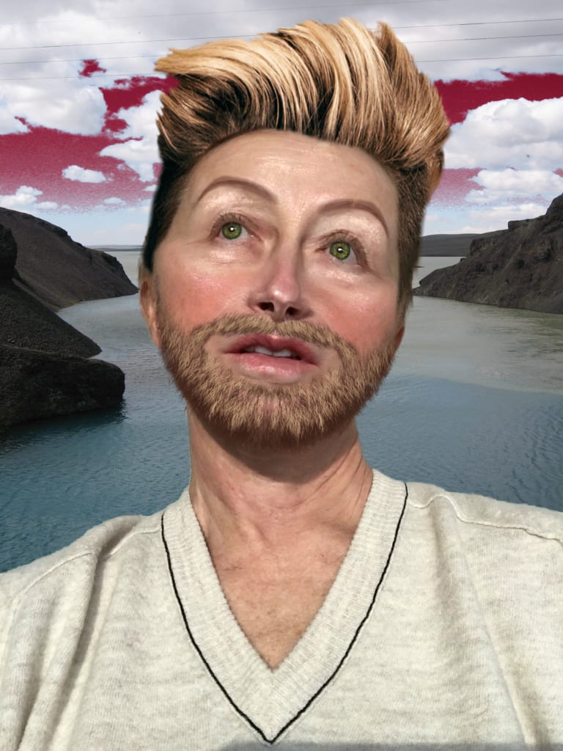
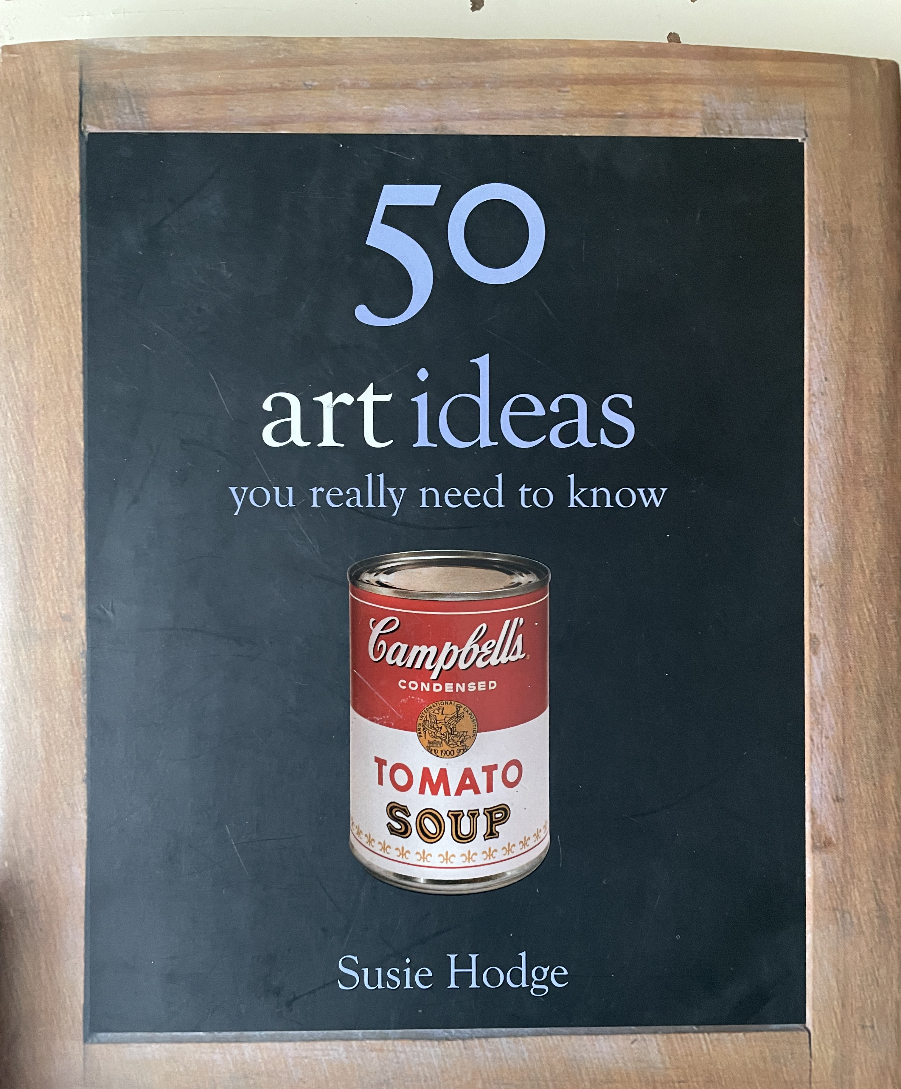
M – Learn the Meaning behind artists’ work
Discover the cognitive thinking process behind the way in which artists interpreted themes, concepts or their ideas. How did they represent meaning in what they did and then crucially, how might you reapply and reinvent it?
www.paulcarneyarts.com
Cindy Sherman
Selfie 2006

Slide 10
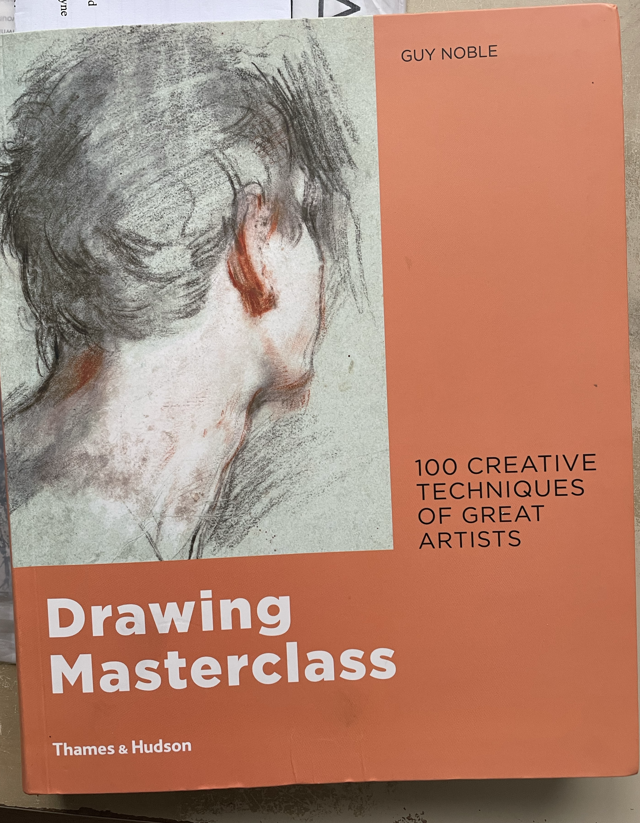
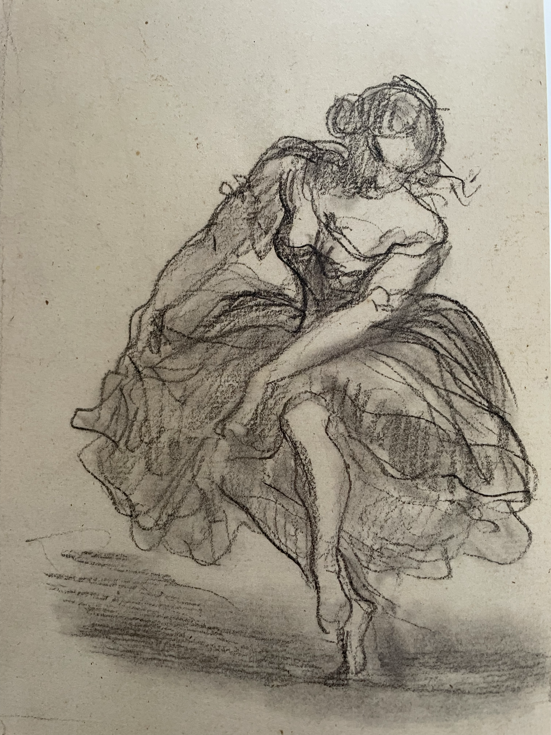
S - Use artists to develop Skills & techniques
Use the work of other artists to learn new techniques or to overcome specific, personal struggles
www.paulcarneyarts.com

Slide 15
https://www.dropbox.com/s/rav5x17eqv7b6ne/Questions.pdf?dl=0

