Slide 1
Graffiti Lettering
By Paul Carney
www.paulcarneyarts.com

Slide 2
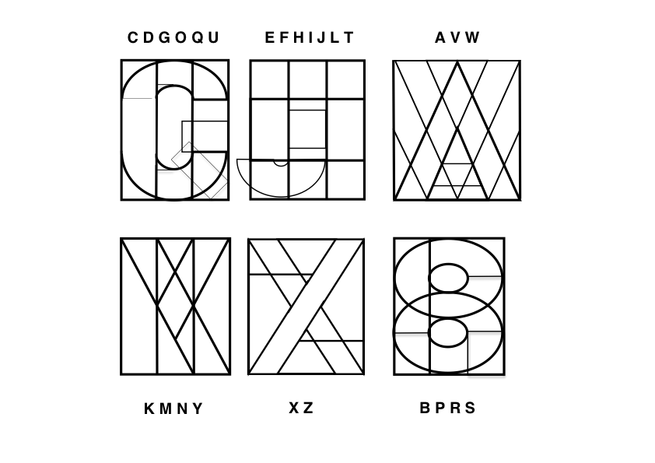
Block Lettering Copyright Paul Carney Arts
www.paulcarneyarts.com
B P R S

Slide 3
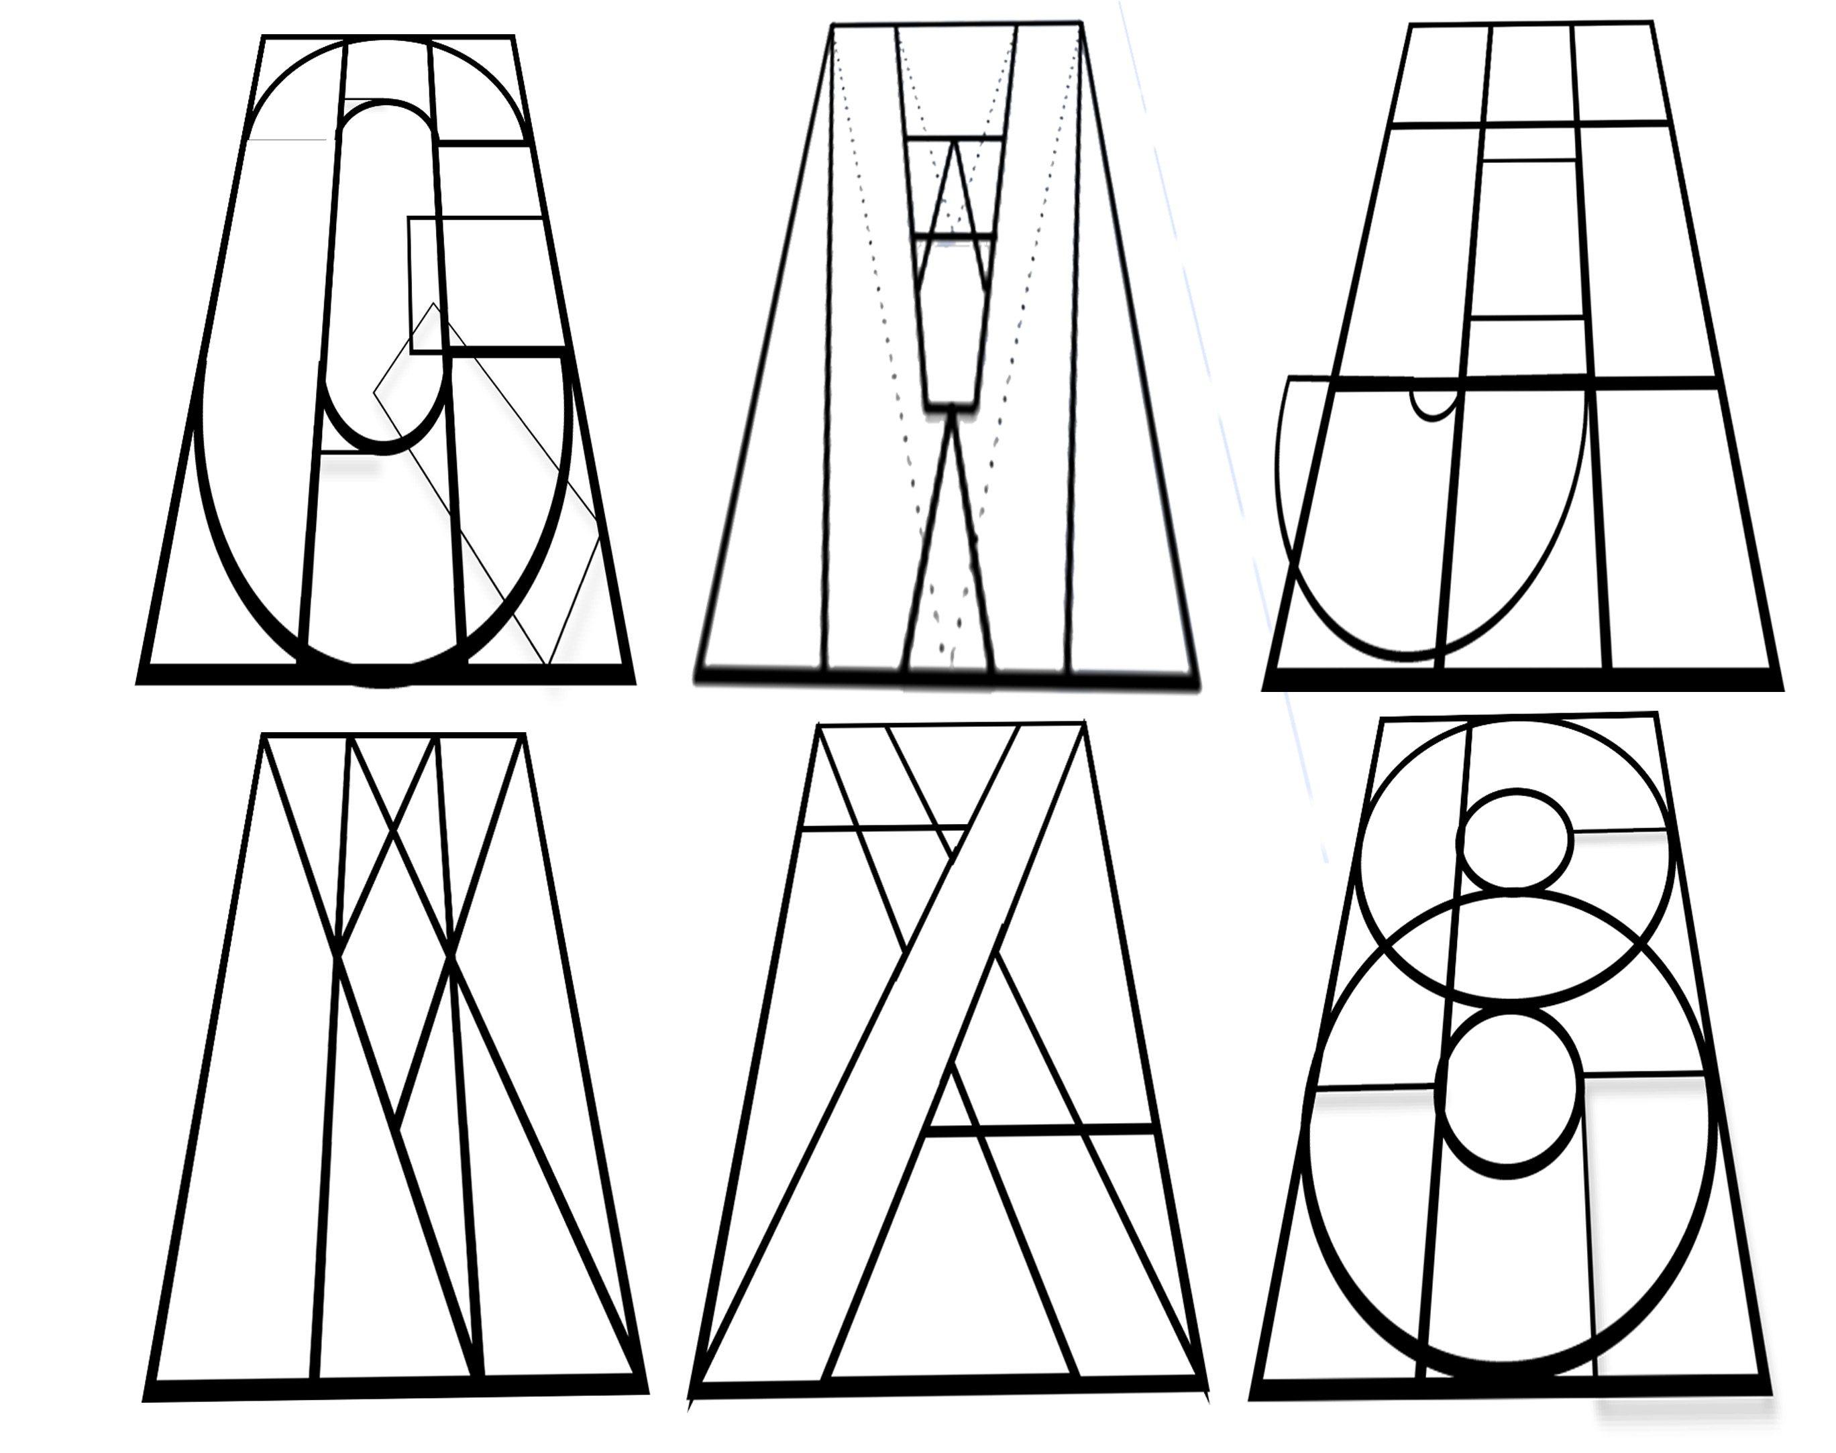
Perspective Lettering Copyright Paul Carney Arts
C D G O Q U
A V W
E F H I J L T
www.paulcarneyarts.com
K M N Y
X Z
B P R S

Slide 4
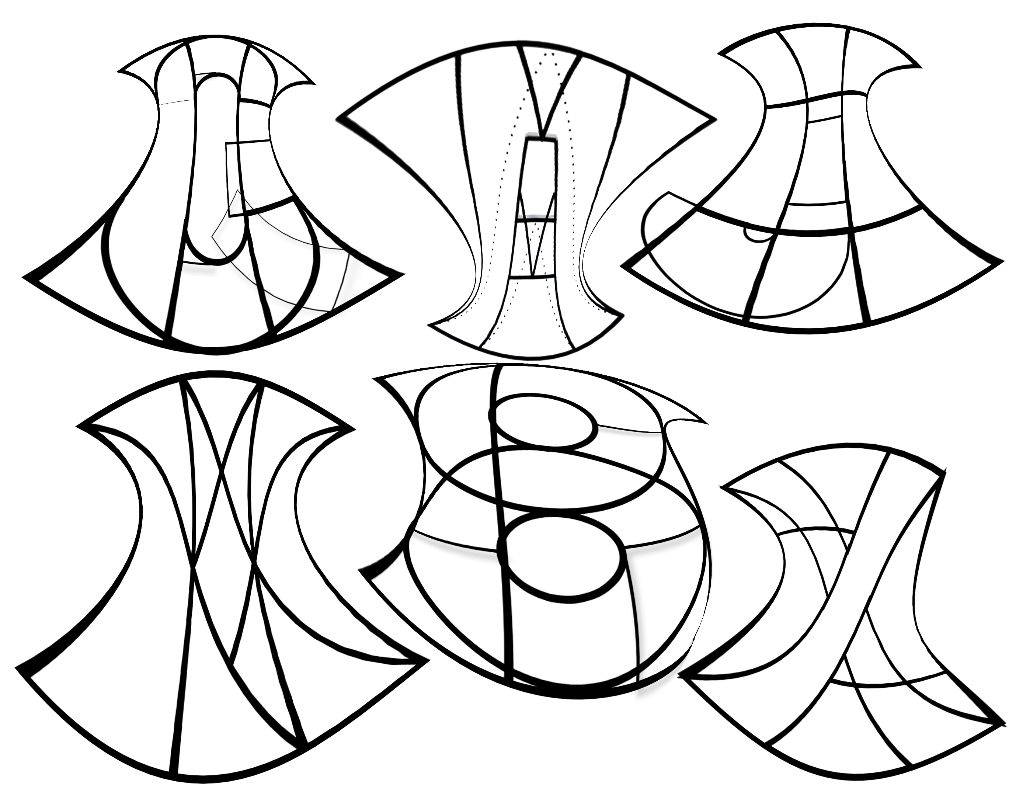
Warped lettering Copyright Paul Carney Arts
C D G O Q U
A V W
E F H I J L T
www.paulcarneyarts.com
K M N Y
X Z
B P R S

